Slide 1

DATAProX: Network-based Data Loss Prevention System
Detecting and preventing sensitive data breaches

Slide 2





Overview of DATAProX
Comprehensive DLP Solution
Monitors HTTP/HTTPS traffic to prevent data breaches
Traffic Analysis
Analyzes outgoing traffic for sensitive data patterns
Pattern Matching
Uses regex patterns and file hash checks
Real-time Protection
Intercepts sensitive data before transmission

Slide 3

Key Features of DATAProX
1
HTTPS Monitoring
Intercepts HTTPS traffic using proxy setup
2
Pattern Matching
Identifies sensitive data using regex-based detection
3
File Hash Verification
Compares file hashes with known malicious database
4
Real-time Alerts
Instantly alerts admins and blocks transmission attempts

Slide 4
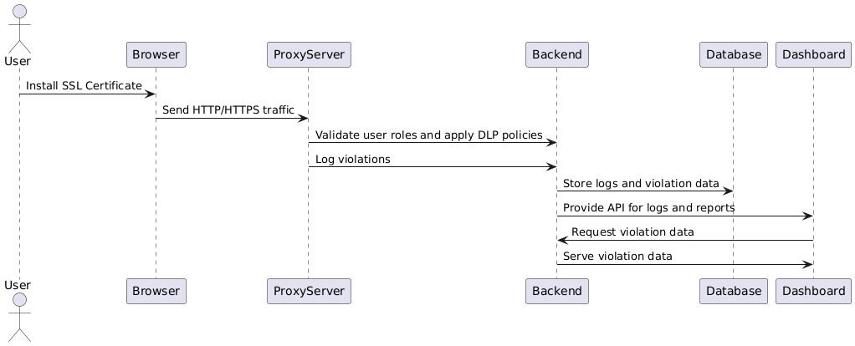
Data Flow Diagram

Slide 5
Monitoring HTTP/HTTPS Traffic
Mitmproxy Setup
TLS/SSL Decryption
Complete Coverage
Uses mitmproxy to decrypt and analyze HTTPS traffic
Decrypts HTTPS traffic for inspection
Captures all HTTP and HTTPS data transmission

Slide 6

Pattern Matching for Sensitive Data
1
Customizable Patterns
Uses regex-based detection for sensitive information identification
2
Pattern File Storage
Stores regex patterns externally for quick updates
3
Blocking Mechanism
Immediately blocks transmission of detected sensitive information

Slide 7

File Upload Hash Checking
Hash Verification
Malicious File Database
Blocking Process
Computes file hashes and compares against known database
Logs violation and blocks upload of matching files
Contains hashes of recognized dangerous files

Slide 8
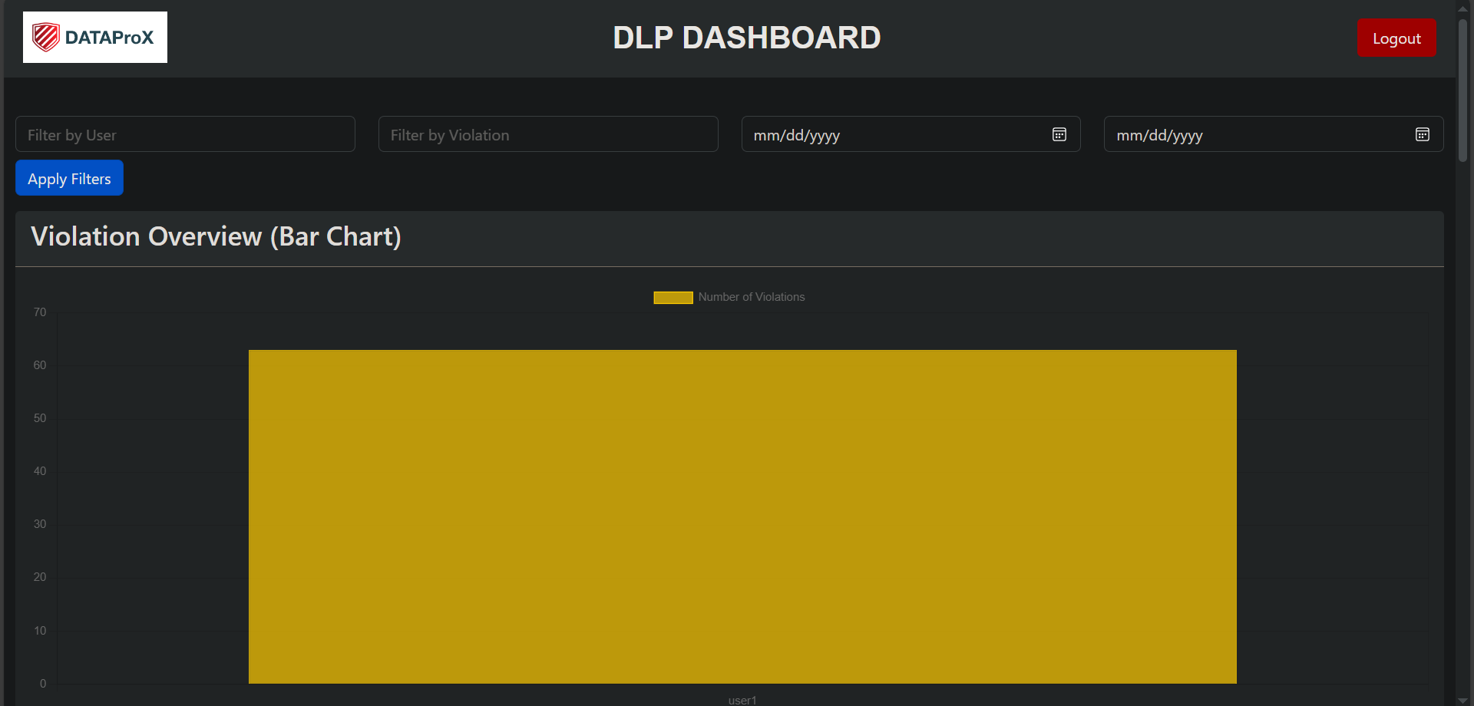
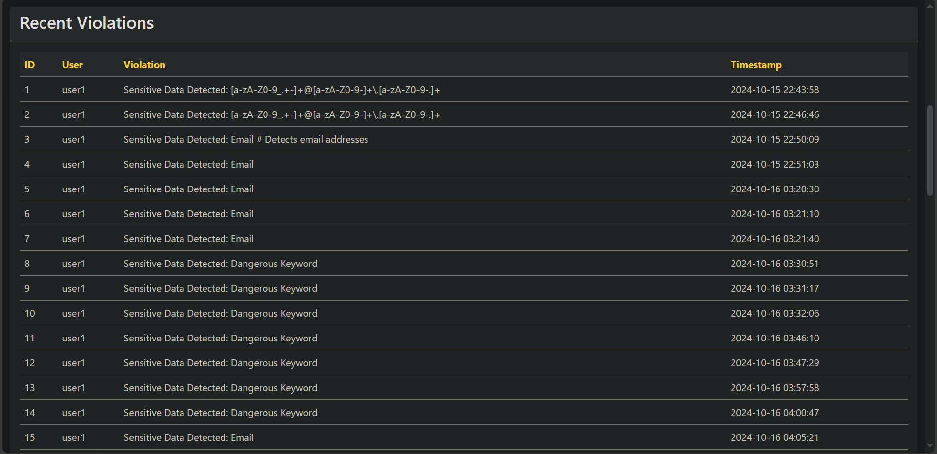
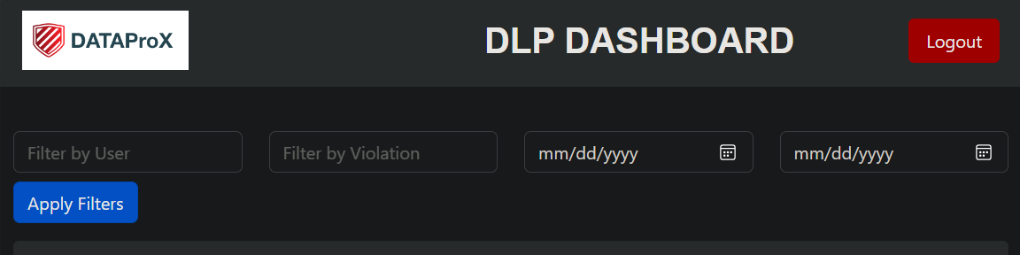
Real-Time Dashboard
Real-time Updates
Violation Details
Filtering Options
Provides real-time alerts using WebSockets
Displays detailed logs of each incident
Includes filters for sorting violations

Slide 9





Technologies Used
Backend
Frontend
Flask and SQLAlchemy for robust architecture
HTML, Bootstrap, and JavaScript for
responsive dashboard
Proxy
Database
Mitmproxy for capturing and analyzing traffic
SQLite for storing violation data

Slide 10




Future Enhancements
User Authentication
Implement role-based access control for administrators
Machine Learning Integration
Enhance pattern detection with machine learning
Additional Protocol Monitoring
Expand support for FTP and SMTP

